Slide 1
Logic circuits
Terebes Liviu Cristian

Slide 2
Task
Write a Boolean function of 4 variables given by its table of values, simplify it and draw the logic circuits corresponding to all its simplified forms.

Slide 3
Simplification procedure
The simplification process used in this case is described as follows:
1. The function f is transformed into DCF(f)
2. We place the found minterms (from DCF(f)) in a Veitch diagram
3. We obtain the set of maximal monoms (M(f)) from the diagram, by applying factorizations as follows: 4-factorization, 3-factorization…0-factorization (in each k-factorization process we try to find a monom which contains the common variables of all 2^k neighbor cells)
4. We select the set of central monoms (C(f)) from M(f) (if a group of minterms covered by a maximal monom m_{a} contains at least one minterm circled once, then m_{a}∈C(f))
5. We identify the case of the simplification algorithm and we obtain all the simplified forms of f.

Slide 4
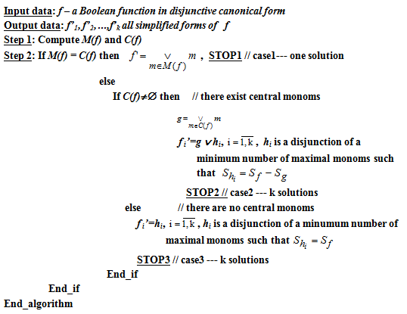
Simplification algorithm

Slide 5
The Boolean function and its DCF
a | b | c | d | f(a,b,c,d)
0 | 0 | 0 | 0 | 1
0 | 0 | 0 | 1 | 0
0 | 0 | 1 | 0 | 0
0 | 0 | 1 | 1 | 1
0 | 1 | 0 | 0 | 1
0 | 1 | 0 | 1 | 1
0 | 1 | 1 | 0 | 0
0 | 1 | 1 | 1 | 1
1 | 0 | 0 | 0 | 1
1 | 0 | 0 | 1 | 0
1 | 0 | 1 | 0 | 0
1 | 0 | 1 | 1 | 1
1 | 1 | 0 | 0 | 1
1 | 1 | 0 | 1 | 0
1 | 1 | 1 | 0 | 0
1 | 1 | 1 | 1 | 1
Remark: The disjunctive canonical form, DCF, is the disjunction of the minterms corresponding to the value 1 of the function.
So, we can see that:
DCF(f) = m₀ ∨ m₃ ∨ m₄ ∨ m₅ ∨ m₇ ∨ m₈ ∨ m₁₁ ∨ m₁₂ ∨ m₁₅
Or,
DCF(f) = a⁰b⁰c⁰d⁰ ∨ a⁰b⁰c¹d¹ ∨ a⁰b¹c⁰d⁰ ∨ a⁰b¹c⁰d¹ ∨ a⁰b¹c¹d¹ ∨ a¹b⁰c⁰d⁰ ∨ a¹b⁰c¹d¹ ∨ a¹b¹c⁰d⁰ ∨ a¹b¹c¹d¹
DCF(f) = a̅ b̅ c̅ d̅ ∨ a̅ b̅ c d ∨ a̅ b c̅ d̅ ∨
a̅ b c̅ d ∨ a̅ b c d ∨ a b̅ c̅ d̅ ∨ a b̅ c d ∨
a b c̅ d̅ ∨ a b c d

Slide 6
Placing the minterms in a Veitch diagram
DCF(f) = m₀ ∨ m₃ ∨ m₄ ∨ m₅ ∨ m₇ ∨ m₈ ∨ m₁₁ ∨ m₁₂ ∨ m₁₅
a
a̅
m₁₅ |  | m₅ | m₇
 | m₁₂ | m₄
 | m₈ | m₀
m₁₁ |  |  | m₃
d
b
d̅
b̅
d
c
c̅
c

Slide 7
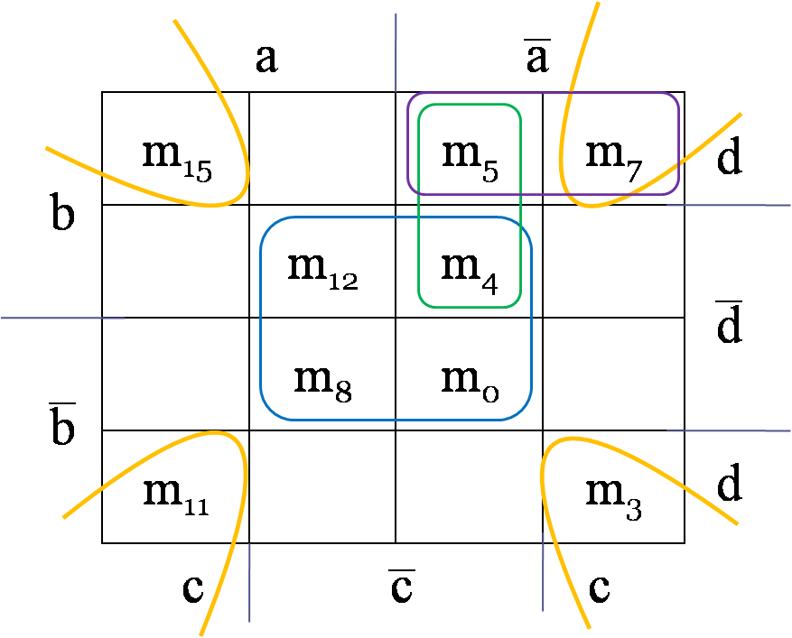
Factorization
DCF(f) = m₀ ∨ m₃ ∨ m₄ ∨ m₅ ∨ m₇ ∨ m₈ ∨ m₁₁ ∨ m₁₂ ∨ m₁₅
The Veitch diagram:
Two double factorizations:
max₁ = m₁₂ ∨ m₄ ∨ m₈ ∨ m₀ = c̅ d̅
max₂ = m₁₅ ∨ m₇ ∨ m₁₁ ∨ m₃ = cd
Two simple factorizations :
max₃ = m₅ ∨ m₇ = a̅bc̅
max₄ = m₅ ∨ m₄ = a̅bd
So, M(f) = {max₁, max₂, max₃, max₄}

Slide 8
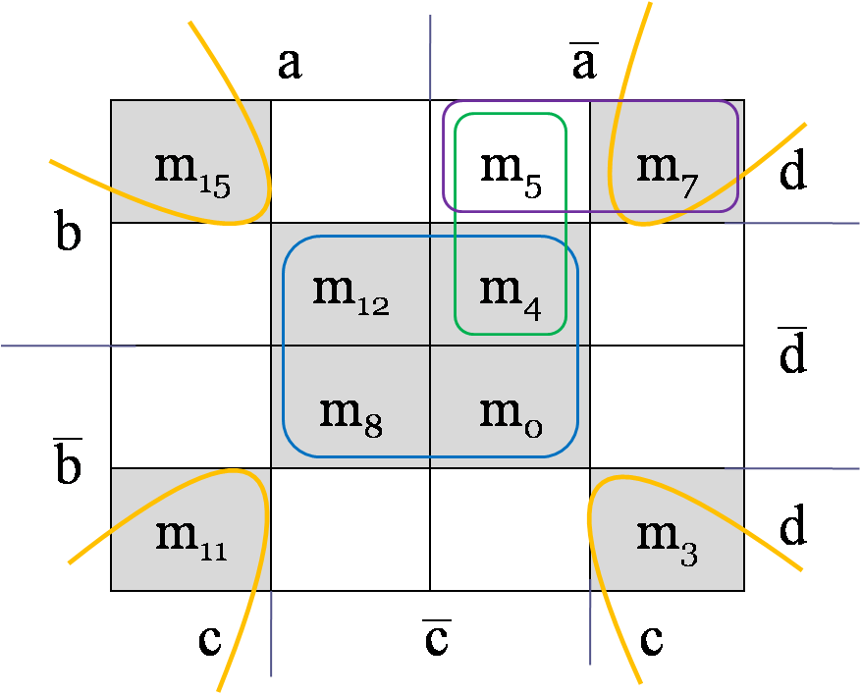
Simplification of the function
The Veitch diagram:
max₁ = m₁₂ ∨ m₄ ∨ m₈ ∨ m₀ = c̅ d̅
max₂ = m₁₅ ∨ m₇ ∨ m₁₁ ∨ m₃ = cd
max₃ = m₅ ∨ m₇ = a̅bc̅
max₄ = m₅ ∨ m₄ = a̅bd
M(f) = {max1, max2, max3, max4}
C(f) = {max1, max2}
M(f) ≠ C(f) and C(f) ≠ ∅, so we are in the second case of the simplification algorithm
We denote by g = max₁ ∨ max₂
g = c̅ d̅ ∨ cd
We obtain two simplified forms of f:
f^{S}₁ = g ∨ max₃ = c̅ d̅ ∨ cd ∨ a̅bc̅
f^{S}₂ = g ∨ max₄ = c̅ d̅ ∨ cd ∨ a̅bd

Slide 9
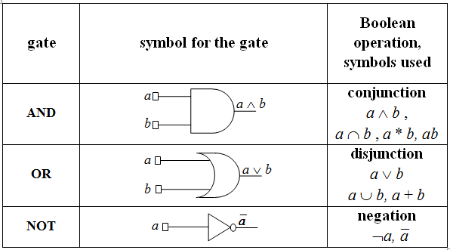
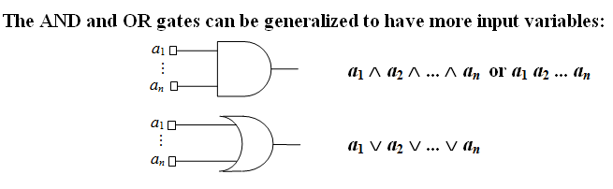
Logic circuits

Slide 10
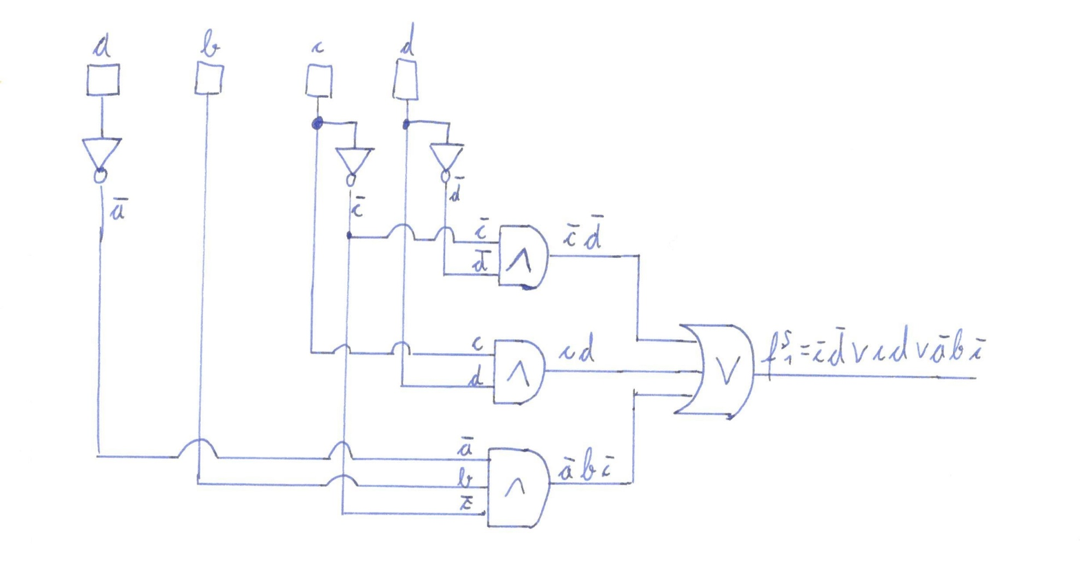
First circuit
f^{S}₁ = c̅ d̅ ∨ cd ∨ a̅bc̅

Slide 11
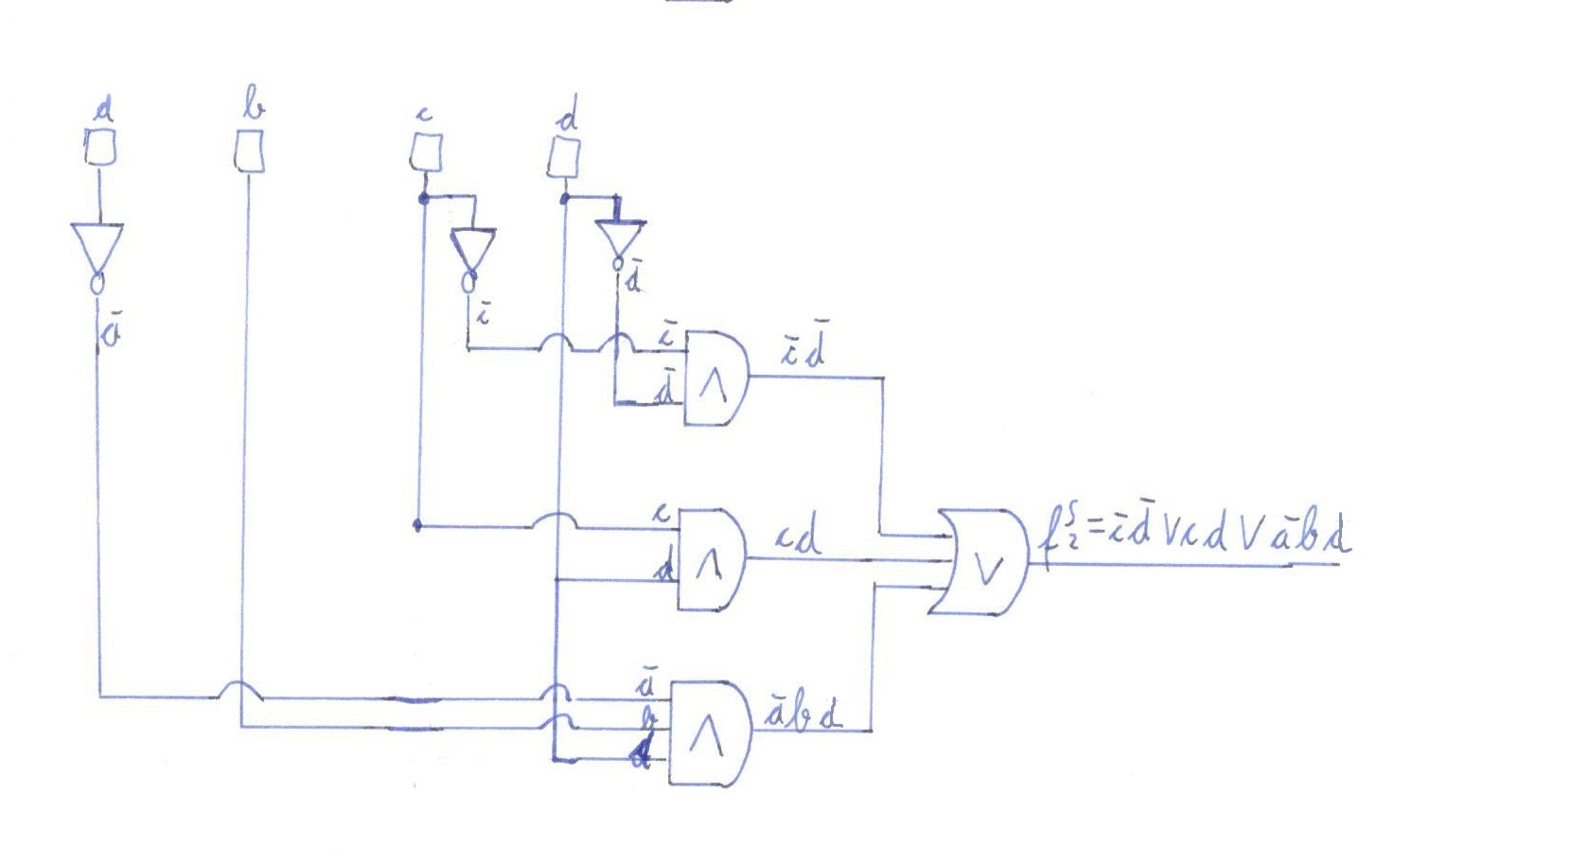
Second circuit
f^{S}₂ = c̅ d̅ ∨ cd ∨ a̅bd

Slide 12
Thank you for your attention!

